Slide 1


Department of Computer Science and Engineering
Project Work Phase – I
First Review
MULTIMODAL OFFLINE RETRIEVAL-AUGMENTED GENERATION (RAG) SYSTEM
Batch Members:
INBAN K 727723EUCS077
JAGATHEESHWARAN J 727723EUCS080
JAISHWANTH N 727723EUCS082
MUKIL T M 727724EUCS510
Batch No.: 9
Supervisor: Dr A.Priya , AP/CSE
Date: 15/07/2026

Slide 2

Problem Statement
Government Data: Agencies handle massive text, image, scanned documents, and audio data.
Search Limitations: Traditional search systems cannot retrieve information across multiple formats.
Security Constraints: Secure environments cannot use cloud-based AI due to confidentiality.
Manual Analysis: Manual inspection of documents and media is extremely time-consuming.

Slide 3
Scope & Objectives
Multimodal Search: Retrieve information from text, image, and audio files.
Semantic Retrieval: Enable high-accuracy semantic search across all local formats.
Context Generation: Generate context-aware responses using localized LLMs.
Offline Deployment: Support localized deployment in restricted or secure environments.
Strategic Impact: Improve overall decision-making speed and accuracy.

Slide 4

Sustainable Development Goals - Mapping
SDG 9: Industry, Innovation and Infrastructure

Slide 5
Literature Review
Research Focus: Study on RAG, semantic search, and multimodal retrieval methods.
Infrastructure Gap: Existing retrieval systems depend heavily on cloud infrastructure.
Key Paper 1: Retrieval-Augmented Generation for Knowledge-Intensive NLP Tasks (2021)
Key Paper 2: Retrieval-Augmented Generation for Large Language Models: A Survey (2024)

Slide 6
Existing Technology
Keyword-Based: Traditional search systems rely on simple keyword matches.
Cloud Assistants: Common AI assistants require cloud-based API infrastructure.
OCR & Speech: Standard OCR and speech processing tools are disjoint and manual.
Major Limitations: Poor contextual understanding, internet dependency, and data security concerns.

Slide 7
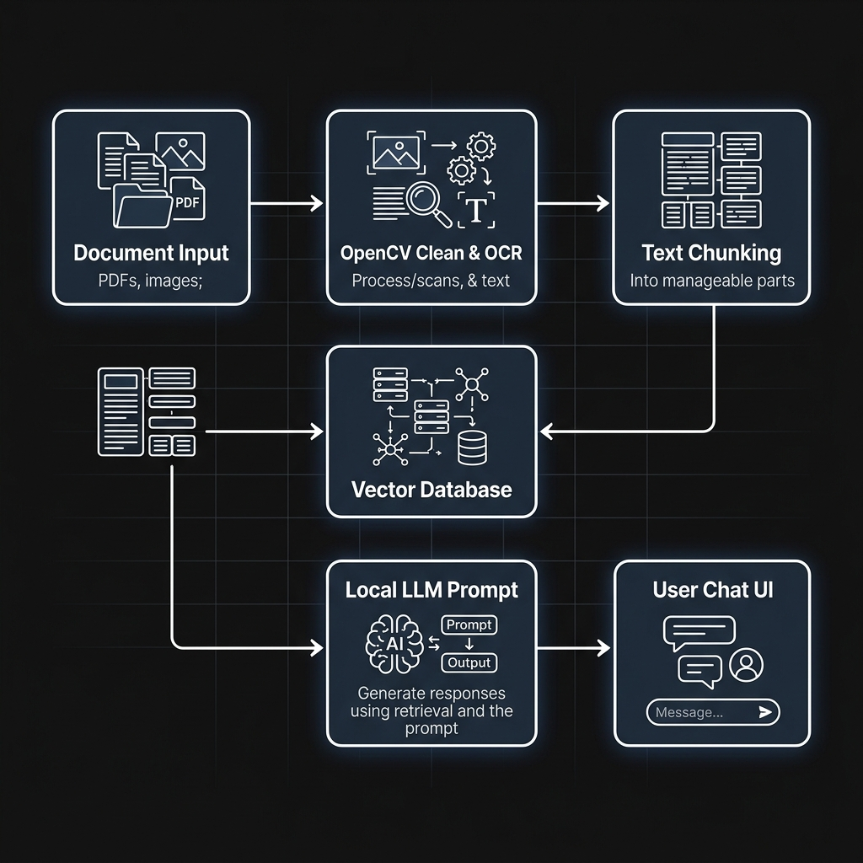
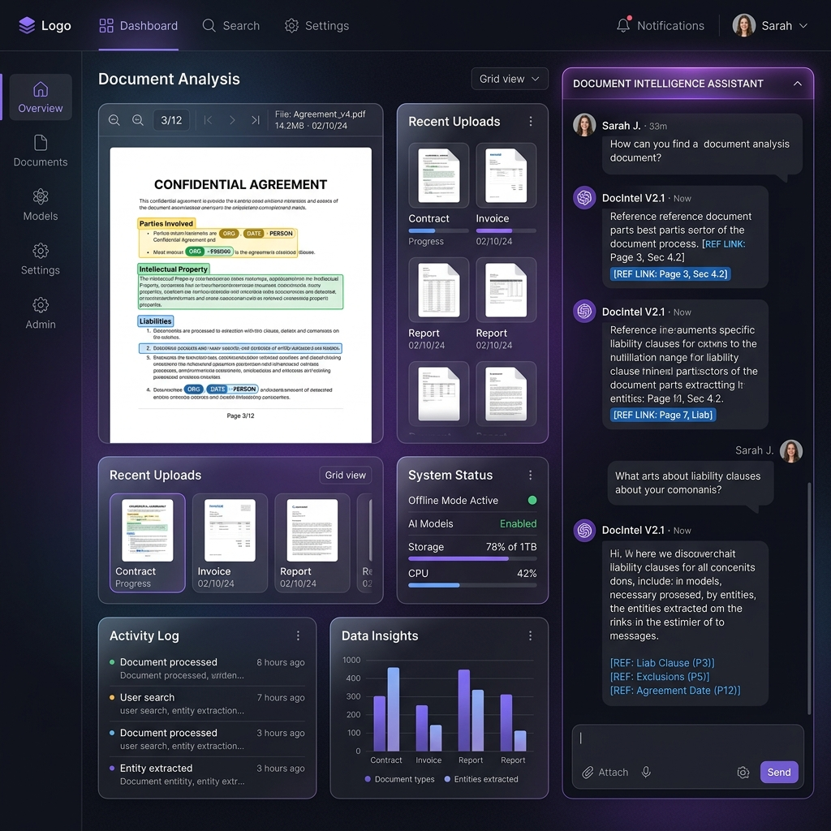
System Workflow & Interface

Slide 8
Work Accomplished (Implementation)
• Module 1 (Image Ingestion): Secure upload portal and SQLite metadata database registry.
• Module 2 (OCR): OpenCV preprocessing filters (CLAHE, Hough line deskewing), Tesseract layout TSV grid parsing, DCS confidence scoring, and bounding box overlays.
• Module 3 (Chunking): OCR text layout sanitizers and Recursive text chunking (500 size, 50 overlap).
• Module 4 (Vector Index): HuggingFace embedding calculator and persistent ChromaDB collection indexing, with a Native SQLite Vector similarity store fallback.
• Modules 5 & 6 (RAG Chat UI): Local Ollama Llama 3 connector, dynamic context prompt compiler, collapsible source citations, and mock responder fallbacks.

Slide 9
Technologies & Tech Stack Used
• Backend Framework: FastAPI (Python 3.12) asynchronous REST API services.
• Frontend Dashboard: React 18, Vite Bundler, and custom dark-mode CSS tokens.
• Image Processing & OCR: OpenCV (binarization/straightener) & Tesseract OCR engine.
• Vector Embeddings Model: Sentence-Transformers (BAAI/bge-base-en-v1.5).
• Vector Database: ChromaDB & Native SQLite Vector Store (numpy cosine searches).
• Local Language Model (LLM): Ollama runner (quantized Llama 3 8B model).
• Metadata Store: SQLite embedded database ledger.

Slide 10
Expected Outcomes & Future Roadmap
• Deliverable Outcome: Secure, 100% offline on-premises document intelligence system, protecting classified information on secure air-gapped networks.
• Future Phase 2 (PDF Documents): Multi-page PDF text extraction and tabular markdown data parsing using pdfplumber/camelot-py. (Timeline: Weeks 7-8)
• Future Phase 3 (Audio Documents): Local speech-to-text transcript generator using quantized OpenAI Whisper. (Timeline: Weeks 9-10)
• Future Phase 4 (Unified Chat): Integrated cross-media querying across PDF manuals, scan images, and audio briefings. (Timeline: Weeks 11-12)

Slide 11
Reference(s)
1. Retrieval-Augmented Generation for Knowledge-Intensive NLP Tasks (2021)
2. Retrieval-Augmented Generation for Large Language Models: A Survey (2024)

